Slide 1
Agentic RAG Chatbot (Local, No API Key)
By Sneha Jha
Github Link

Slide 2
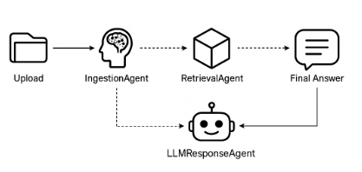
System Architecture with Agentic Design & MCP
Agents:
IngestionAgent: Parses and extracts text
RetrievalAgent: Embeds and retrieves chunks
LLMResponseAgent: Generates final answer

Slide 3
System Flow (Step-by-Step) from Document to Answer
User uploads multiple files (PDF, DOCX, CSV, PPTX, TXT)
IngestionAgent extracts and processes text
RetrievalAgent:
Creates vector embeddings using SentenceTransformers .
Searches for relevant chunks using FAISS
4. LLMResponseAgent:
Uses local model (Flan-T5) to generate answer .
Returns result + source context.
5. UI displays final output to the user

Slide 4
Tech Stack
Layer | Technology Used
UI | Streamlit
LLM | flan-t5-base (via Hugging Face)
Embeddings | all-MiniLM-L6-v2 (SentenceTransformers)
Vector DB | FAISS
Parsing | PyMuPDF, python-docx, pptx, pandas
Protocol | Custom MCP (in-memory JSON messages)

Slide 5
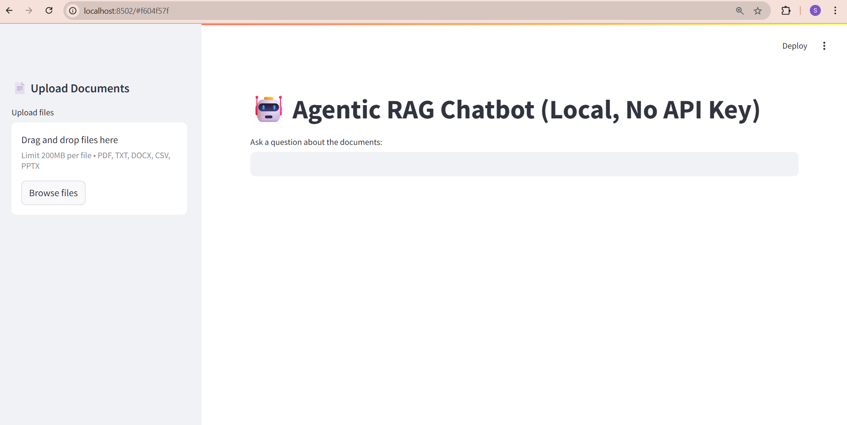
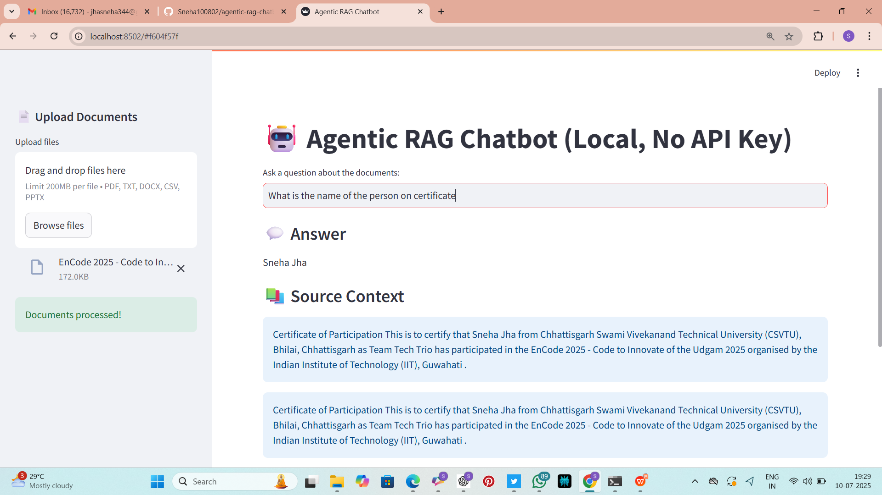
Application Interface
Figure 1 . UI Interface before uploading a document
Figure 2 . UI Interface after uploading a document

Slide 6
Challenges and Improvements
Challenges
Future Improvements
Handling PPTX with inconsistent formatting
Performance optimization for large documents
Running LLMs locally with limited compute
Multi-turn chat with memory
Highlight matching text in documents
Option to download summaries or transcripts
Docker container for deployment

